Slide 1
DW & BI design, E-commerce of Coach, Inc
Final Project of MIS 636
Professor Joseph Morabito
Customer Perspective

Slide 2
Outline
Company Overview
Bus Matrix & Star Schema
Conformed Dimensions
Transformation Rules
Aggregate Tables
Cube
Visualizations/Dashboards
Conclusion

Slide 3
What is Coach Inc…..
Rich Heritage: founded in 1941 as a family-run workshop
Broad Reach: multi-channel distribution strategy
Crafting the future: significant growth home and abroad
Mission Statement
Coach seeks to be the leading brand of quality lifestyle accessories offering classic, modern American styling
Notes:
http://www.coach.com/online/handbags/genWCM-10551-10051-en-/Coach_US/CompanyInformation/InvestorRelations/MissionStatement

Slide 4
E-commerce Why DW & BI?
Improved decision making
Analysis that matches business processes
Data consistency
NOSQL analysis
OLAP tools
Visualizations
Notes:
A more meaningful and visual-friendly (direct? Whichever you choose. )way to interact with data
Quick answers to “what” and “how” questions.
Eliminate manual tasks to compile numerous spreadsheets since all data is shared on a centralized server across the organization., therefore, the data is synchronized and everyone is looking at the same data. What’s more, OLAP cubes allow users to view the same data from multiple points of view. Data is aggregated and summarized across multiple business areas and thus improve the efficient and usability of data.
Improve the data analysis. With multi-dimensions looks at data across different business areas, users will have the ability to access the exactly data they need. Analyst will have the right data at the right time.

Slide 5
Coach – Business Process
 | Date & Time | vendor | Product | Part | Transaction | Customer | Media | Service policy | Status & Types | Carrier
procurement | X | X | X | X | X |  |  |  | X | X
manufacturing | X | X | X | X |  |  |  |  |  | X
sales | X | X | X |  | X | X |  | X | X
inventory | X |  | X |  |  |  |  | X | X | X
HR | X |  |  |  |  | X | X | X | X
financial | X |  | X |  | X |  |  |  | X
payroll | X |  |  |  |  |  |  | X
marketing | X |  |  |  |  |  | X
customer services |  |  |  |  |  | X |  | X
infrastructure and operations | X | X | X |  | X | X | X |  | X | X

Slide 6
Opportunity Matrix -- Sales
Business Process | Customer services | Financial | Operations | Human Resource | Logistics | Strategy manage-ment
Online sales transaction | X | X | X | X | X | X
In-store sales transaction | X | X | X | X |  | X
Vendor sales transaction |  | X |  |  | X
Order processing |  |  | X
Delivery process |  |  | X
Return policy | X | X |  |  | X

Slide 7
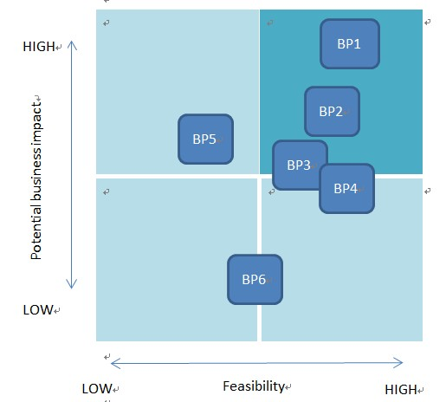
Why E-commerce…?
According to the business processes in opportunity grid…..

Slide 8
E-commerce High Level Bus Matrix
 | Date | Material | Location | Owner | Product | Service policy | Account status | Order | Customer
Online sales transaction | X | X |  |  | X | X | X | X | X
Order processing | X |  | X | X | X | X | X | X | X
Delivery process | X |  | X | X |  | X | X | X | X
Return policy | X |  | X |  |  | X | X | X | X

Slide 9
E-commerce Detailed Bus Matrix
e-commerce business process | fact tables | granularity | fact | Date | Product | Location | Owner | Service policy | Account status
online sales transaction | sales transaction | Per line item | purchase date key purchase amount key purchase unit price key transaction number | x | x |  | x | x | x
 | click stream | Per click | referral key session key time key event key page key | x | x |  |  | x | x
 | Vendor information | Per vendor item | vender number key vendor product amount key ... | x | x | x | x | x
order processing | warehouse picking | Per warehouse receipt | ship date key requested date key product key vendor key | x | x |  | x | x
 | billing and invoicing | Per order | date key order number quantity key product key … | x | x |  | x |  | x
delivery process | shipping notice | Per line item | shipping date key shipping cost key tracking number delivery company key …. | x | x | x | x | x | x
 | delivery operation | Per line item | tracking number shipping date delivery cost key …. | x | x | x |  | x | x
return policy | store return process | Per line item | store number key item number key return date key …. | x | x | x |  | x | x
 | mail return process | Per line item | tracking number return date key | x | x |  | x | x | x
Notes:
Demonstrate the confirmed dimension here

Slide 10
E-commerce Logical Fact Table Diagram – Sales Transaction
Date and Time
Shipment
Facilities Location
Vendor
Sale transaction line item Fact Table
Grain:
line item on online sale transaction
Customer profile
Partner
Product
Employee
Material
Inventory
promotion
Service policy
Owner
Transaction
Payment
Notes:
In this business process we choose, the Sale transaction is the core of it. So We build the Fact Table of Sale transaction line item in the center, which is then surrounded and connected with associated dimensions. These dimensions are involved in our chosen business process.
In the fact table, we need Grain to give a uniform definition for the fact. For Sale transaction line item , good uniform information to define it is some basic data that records each line item of transactions. So line item on online sale transaction are chosen as this grain.

Slide 11
E-commerce Detailed Fact Table – Sales Transaction
Sale transaction line item Fact Table
Transaction_key
Product_key
Date and Time_key
Inventory_key
Shipment_key
Customer profile_key
Promotion_key
Payment_key
Line_Item_quantity
Line_Item_total_price
- Dimension Keys
- FK
Dimensions are the foundation of the fact table, and is where the data for the fact table is collected.
The grain of a fact table represents the most atomic level by which the facts may be defined.
Notes:
The detailed fact table demonstrates the keys of it. As shown in the table, these eight keys are all foreign keys that referred the primary keys of directly connected dimensions.
The Grain contains three basic and also necessary items that define this fact.

Slide 12
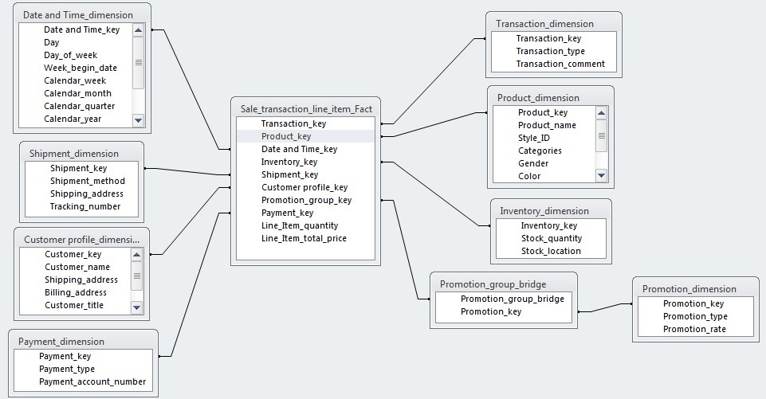
Star Schema of Sale transaction line item fact

Slide 13
E-commerce Dimension Attribute Detail Descriptions – Product_key
Attribute Name | Attribute Description | Cardnality | Slowly Changing Dimension Policy | Sample Values
Product ID | Product ID that Uniquely identifies each product within Coach's online system | 11,237,312(est) | Not Updatable | 4976845982, q390912345, 64512b32456
Product style Name | The full descriptive name of the product style. | 89,243 | Not Updatable | new bleecker canvas city tote, bleecker legacy leather compact id,niles nubuck slip on
Style ID | Style ID that uniquely identifies each style within Coach's online system | 89,243 | Not Updatable | 49768, q3909, 64512b
Categories | The full descriptive name of the Category which certain product belongs to | 13 | Type 2 | Handbags, Shoes, Accessories
Gender | The full descriptive name of the gender that product suits | 3 | Not Updatable | Women, Men
Color | The full descriptive name of the color of product | 83 | Type 2 | SILVER / COBALT, BRASS / PEONY, SV / PEBBLE GREY.
Size | The category of the size of products | 26 | Not Updatable | 7d, 13d, 5.5b
Description | The full descriptive content that describes the details of certain style | 89243 | Type 1 | Intricately woven metallic and vachetta leathers give this striking silhouette a distinctive textural twist, while leather linings and a slender
Collection | The full descriptive name of the collection | 18 | Type 2 | MENS THOMPSON, Central Europe MENS BLEECKER LEGACY, LEGACY WEEKEND
Price | The number that identify the price of the product | - | Type 1
price Band | the numeric range of the price | 5 | Not Updatable | Under 50, 50-100, 100-200, 200-400, 400& above
Review rate | the numeric number which show the review rate of customer | 9 | Not Updatable | 0, 2.5, 5
Notes:
We have designed a table showing dimension attribute detail for our dimensions,
We have the following columns Attribute Name, Attribute Description (describes in details the attributes),
Cardinality (describes the cardinality of the dimension if it exists),
Slowly Changing Dimension Policy, Reason (this describes the reason for the slowly changing dimension policy),
Sample Values (this describes an example of an attribute)
Slowly dimension changing policies are Type 1: when there is no need to keep the history of the data or when correcting the database
essentially it is an overwrite. Type 2: changes in dimensions and associating them with fact tables.

Slide 14
E-commerce Dimension Table Detailed Diagram : Product Dimension
(3)
Gender
(18)
Collection
Review rate
(9)
(89,243)
Description
Review comment
(13)
Categories
(26)
Size
(89,243)
Styles
Price Band
(5)
(38)
Color
Price
Product
Slowly Changing Dimensions:
Categories
Gender
Size
Color
Price Band
(11,237,312 est.)

Slide 15
E-commerce Conformed Dimensions
Standardized conformed dimensions are the goal for any well-architected data warehouse.
In our case E-commerce has the following Conformed Dimensions –
Date and Time Dimension
Product Dimension
Customer Dimension

Slide 16
E-commerce Transformation Rules
Rules Type | Description
Direct assignment | This will copy the value in the source field directly into the target field. For example the customer number, material number will be transformed using direct assignment.
Constants | This transformation rule will fill the target field with a specified value.
Reading master data | The InfoObject is updated by reading the master data table of a characteristic that is included in the source with a key and a value and that contains the corresponding InfoObject as an attribute.
Routines | Routines are special code written to handle complex cases. There are start routines, end routines and expert routine .
Formula | The InfoObject is updated with a value determined using a formula.
Initial | The field is not filled. It remains empty for all the records.

Slide 17
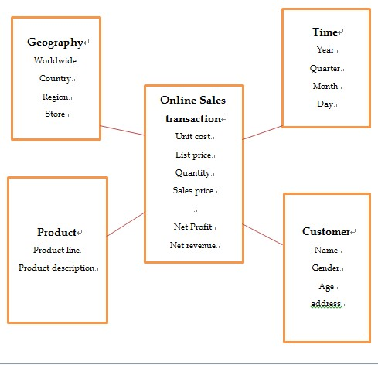
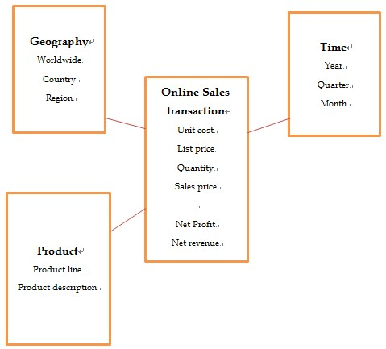
E-commerce Aggregate Tables
Base fact and dimension
Aggregation by region by month

Slide 18
E-commerce Aggregate Table (cont.)
Online Sales Transaction | Product |  |  |  | Geography |  |  |  | Time
 | Productline1 |  | Productline2 |  | Worldwide |  |  |  | Year1 |  |  |  | Year2
 | Product 1 | Product 2 | Product 1 | Product 2 | Country 1 |  | Country 2 |  | Quarter 1 |  | Quarter 2 |  | Q1 | Q2
 |  |  |  |  | Region 1 | Region 2 | Region 1 | Region 2 | Month 1 |  | Month 2 |  | M1 | M2
 |  |  |  |  |  |  |  |  | D1 | D2 | D1 | D2 | D1 | D2
Unit cost
List price
Quantity
Sales price
Net profit
Net revenue
Aggregate table with atomic facts

Slide 19
E-commerce Aggregate Table (cont.)
Online Sales Transaction | Product |  | Geography |  | Time
 | Productline1 | Productline2 | Worldwide |  | Year1 |  | Year2
 |  |  | Country 1 | Country 2 | Quarter 1 | Quarter 2 | Q1 | Q2
 |  |  |  |  | Month 1 | Month 2 | M1 | M2
Unit cost
List price
Quantity
Sales price
Net profit
Net revenue
…
…
…
Aggregate table by productline by country by month
Online Sales Transaction | Product |  | Geography |  | Time
 | Productline1 | Productline2 | Worldwide |  | Year1 |  | Year2
 |  |  | Country 1 | Country 2 | Quarter 1 | Quarter 2 | Q1 | Q2
Unit cost
List price
Quantity
Sales price
Net profit
Net revenue
…
…
…
Aggregate table by productline by country by quarter

Slide 20
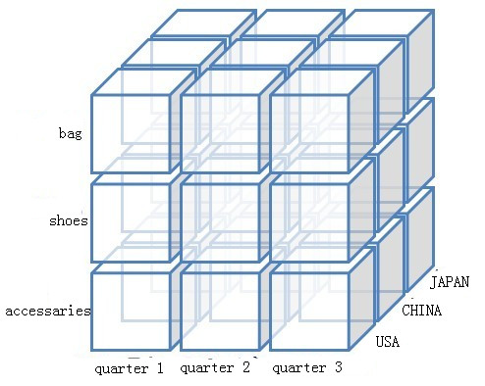
E-commerce Cube

Slide 21

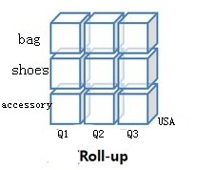
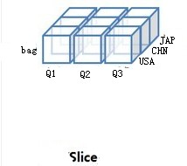
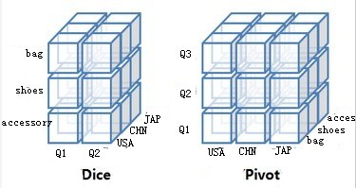
E-commerce Cube(con’t)

Slide 22
E-commerce User & Task Analysis (con’t)
Operational
Lowest level entry point with limited data on a specific business process
Informative explanatory visualization
External Customer
Lower level entry point with both summary and drill down capability
Hybrid persuasive exploratory – informative explanatory visualization

Slide 23
E-commerce User & Task Analysis
Executive/Management
High level entry point with summary data and drill down capability
Primarily informative explanatory visualization
Business Analyst
High level entry point with summary data, drill down and drill across capabilities
Hybrid exploratory – informative explanatory visualization

Slide 24
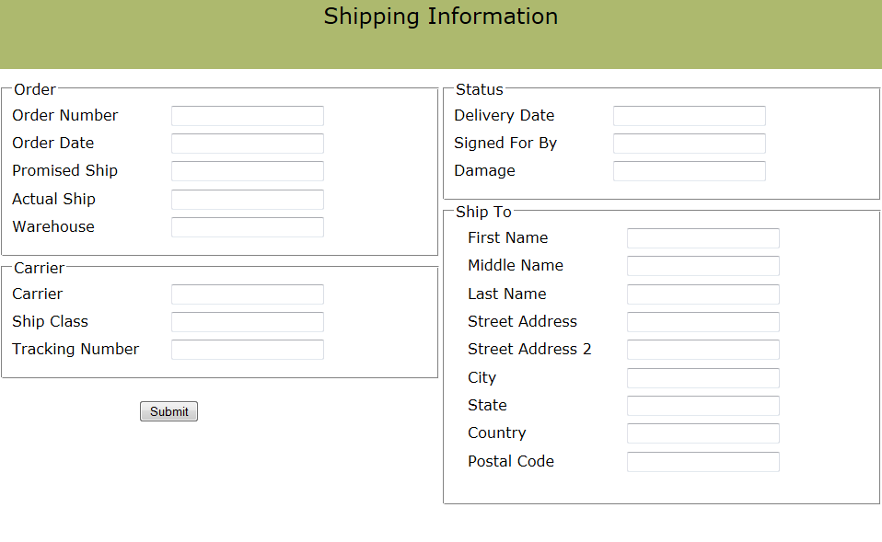
E-commerce BI Portal Landscape – Operational
Notes:
The Operational interface is a low level entry point providing limited data on a specific business process. It is an example of an informative explanatory visualization.

Slide 25
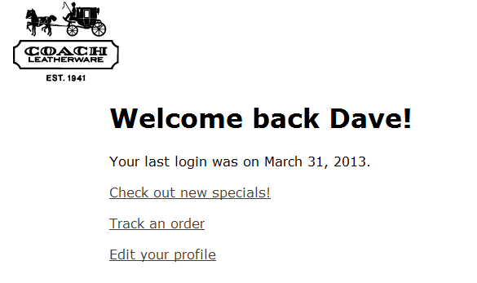
E-commerce BI Portal Landscape – Customer
Notes:
The Customer interface is a mid level entry point providing portal access to customer-specific data. It is an example of an informative explanatory / exploratory visualization in combination with a persuasive visualization intended to promote additional purchases.

Slide 26
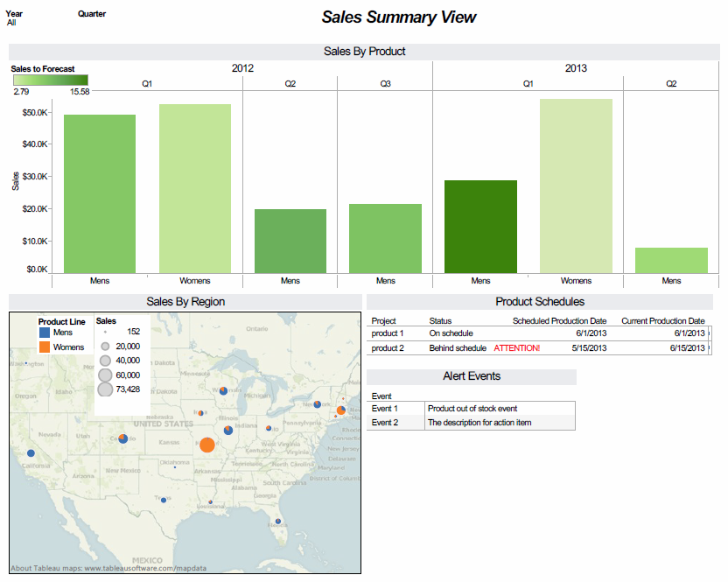
E-commerce BI Portal Landscape - Executive
Notes:
The Executive view we have chosen to evaluate is the one for the VP of Sales. This role is primarily concerned with revenue to plan, making sure that the companies sales meet or exceed the revenue targets established by upper management. Therefore, the VP of Sales requires the following information:
YTD sales
Regional breakdown of sales
Sales to plan
New Product status
Alerts of significant events

Slide 27
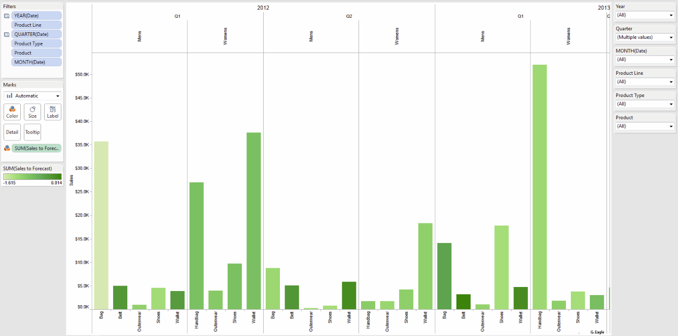
E-commerce BI Portal - Executive Drill Down

Slide 28
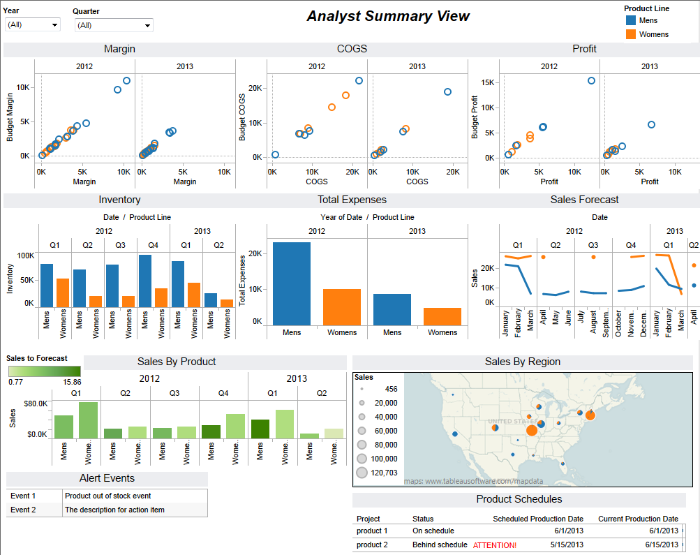
E-commerce BI Portal Landscape - Analyst
Notes:
The Business Analyst is concerned with more fundamental aspects of revenue generation, and therefore is interested in lower-level information that indicates areas in which cost savings and greater efficiencies can be achieved. The business analyst is interested in the following types of information:
Sales / revenue
Costs / profit
Inventory
Associated purchases
Trending/Forecasting

Slide 29
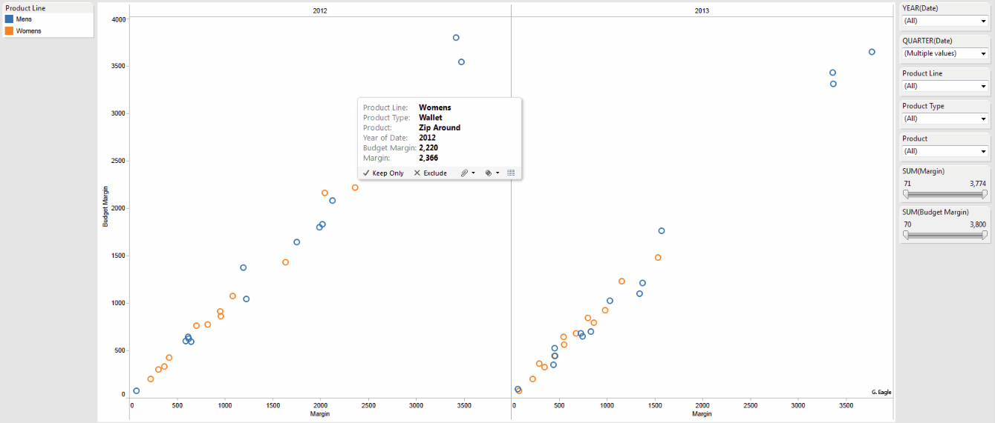
E-commerce BI Portal Landscape – Analyst Drill Down

Slide 30
E-commerce Implementation Considerations
Response time
Query performance
Materialized views
MHC
OLAP cache
Notes:
The response time. The performance of data warehousing is largely depending on query performance. Queries usually either select a very small set of data or perform aggregations on a fairly large data set. Although materialized views that stores pre-calculated aggregates are efficiently used to process queries with aggregations, this approach increases resource requirements in disk space and slows down updates because of the view maintenance problem. Multidimensional hierarchical clustering (MHC) of OLAP data overcomes these problems while offering more flexibility for aggregation paths. Clustering is introduced as a way to speed up aggregation queries without additional storage cost for materialization. Another way is to use the BW OLAP cache.

Slide 31
Questions? You can clap now….

